Slide 1

Flight Reservation System Project Overview
This project report presents a console-based Flight Reservation System developed in C, designed to simulate airline booking functionalities. It uses arrays to manage flights and linked lists to handle passenger details dynamically. The system supports booking, cancellation, flight display, and passenger listing, demonstrating core data structure concepts and memory management in C.
Developed by K. Nithin Sai, K. Mohith Kumar, M. Shyam, and N. Srivardhan under the guidance of Mrs.P. Suneetha man /Mr.Sivanraj sir at N.B.K.R. Institute of Science and Technology, this project aims to provide a foundational understanding of reservation systems.

Slide 2
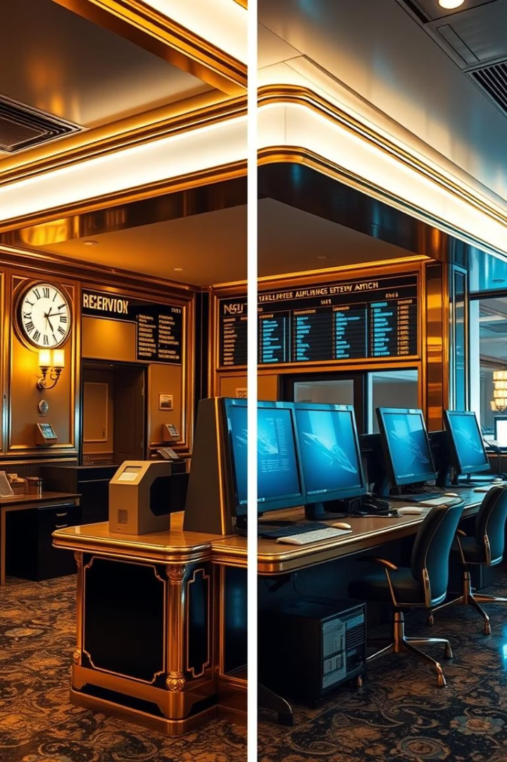
Background and Objectives
Background
The aviation industry's growth demands efficient reservation systems. Traditional manual bookings are error-prone and slow, leading to the rise of computerized systems for real-time data handling and improved customer satisfaction.
Objectives
Design a flight reservation system using C.
Manage flights with arrays and passengers with linked lists.
Implement booking, cancellation, and information display features.
Enhance understanding of data structures and memory management.

Slide 3

Existing Systems and Their Limitations
Traditional Systems
Limitations
Manual bookings were time-consuming and error-prone. Early computer reservation systems improved efficiency but lacked passenger autonomy and real-time updates.
Limited seat selection and boarding pass printing.
Delayed notifications on cancellations or delays.
Data silos hindered information sharing.
Security vulnerabilities in centralized databases.
Modern Advances
New systems use user-centered design, microservices, AI for dynamic pricing, and blockchain for secure transactions, enhancing efficiency and customer experience.

Slide 4
System Requirements and Design
Requirements Analysis
Design Objectives
Functional: Flight and passenger management, seat allocation, search.
Modularity for flight, passenger, and UI modules.
Efficiency using arrays and linked lists.
Non-Functional: Performance within 2 seconds, usability, reliability, maintainability.
Scalability and maintainability.
Console interface with clear menus and input validation.
Constraints: C language, arrays and linked lists, console-based on Windows/Linux.

Slide 5




Proposed System Architecture and Features
Flight Management
Add, update, delete flights; display flight details including seat availability.
Passenger Management
Book and cancel reservations; list passengers per flight using linked lists.
Search and Persistence
Search flights by criteria; store data in files to maintain session continuity.
Advantages
Improved efficiency, accessibility, data integrity, and scalability over traditional systems.

Slide 6
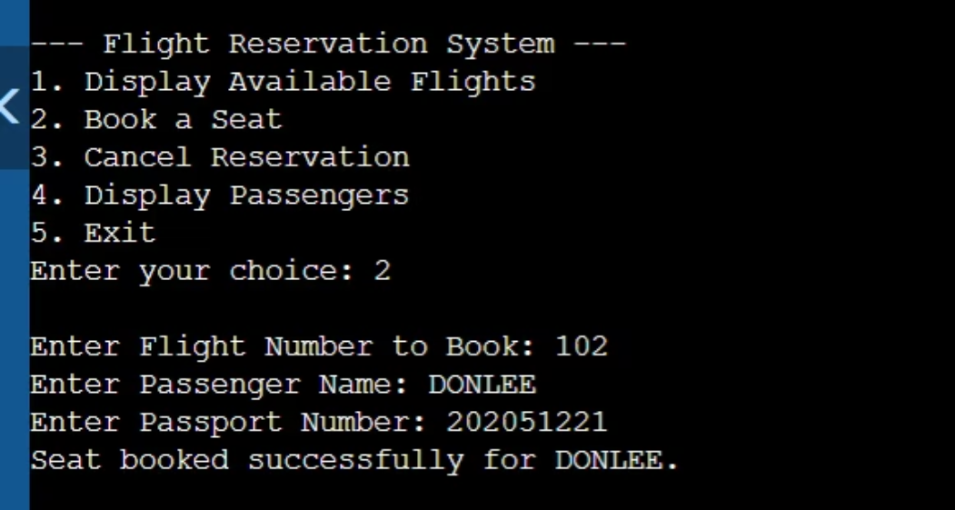
OUTPUT

Slide 7
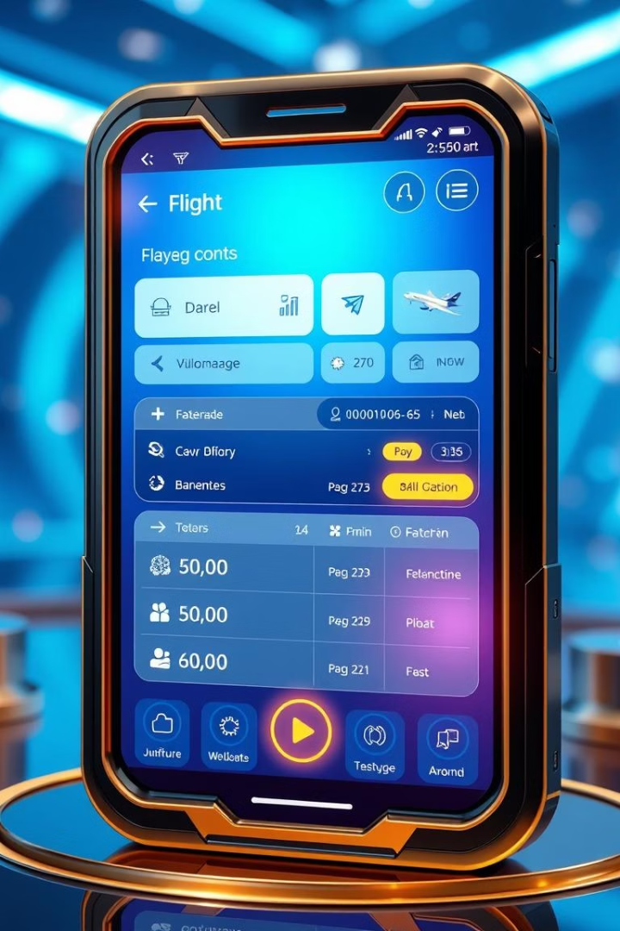
Conclusion and Future Enhancements
Conclusion
The system effectively demonstrates data structure use in flight reservations with a user-friendly console interface and data persistence, serving as a foundational educational tool.
Future Work
Develop GUI for better user experience.
Integrate databases for robust data management.
Implement authentication and real-time flight info.
Expand to mobile apps, multilingual support, and advanced search.

Slide 8
THANK YOU VERY MUCH!!!!!

